Slide 1
Educational Question-Answer Forum for Bangladesh
Presented by
Tulshi Chandra Das
Supervised by
md. Saeed siddik
Lecturer
Iit, Du

Slide 2
Outline
Introduction
Activity Diagrams
ER diagram
Class collaboration diagram

Slide 3
Introduction
Concept of Educational Question Answer Forum
Creating question on study topics
Creating answer to a question
Comment to question or answer
Vote/Down-vote to question/answer
Reputation system
User profiling

Slide 4
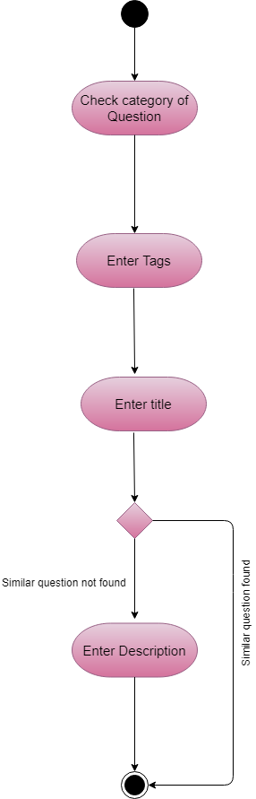
Activity Diagram- Create Question

Slide 5
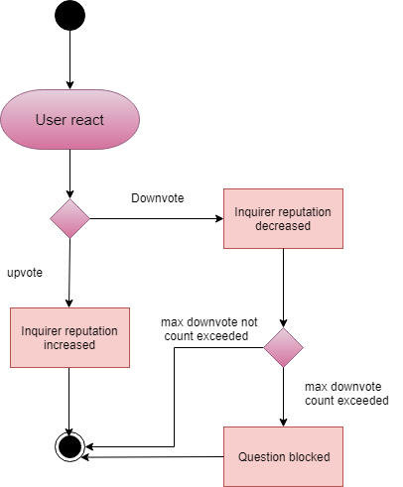
Activity Diagram- User reaction to question

Slide 6
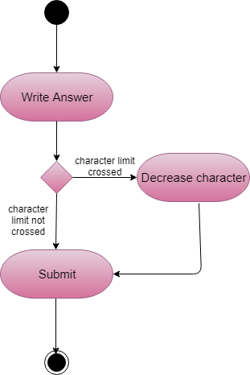
Activity Diagram- Answer to question

Slide 7
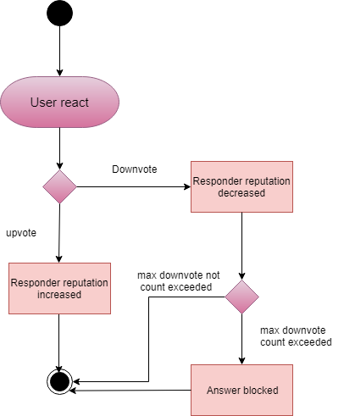
Activity Diagram –User reaction to Answer

Slide 8
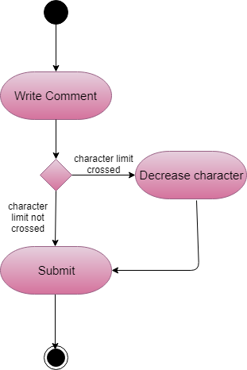
Activity Diagram- User comment

Slide 9
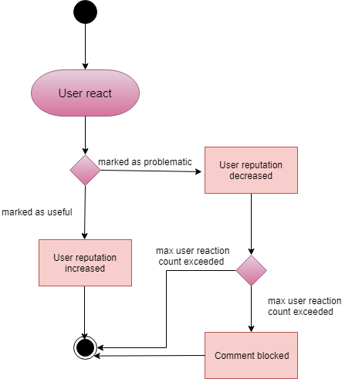
Activity Diagram- user reaction to comment

Slide 10
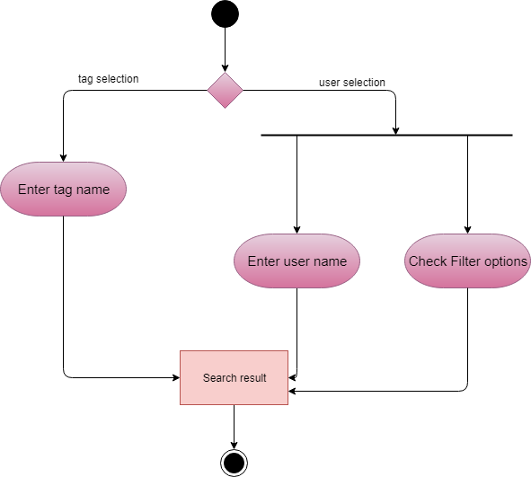
Activity Diagram- Search users

Slide 11
Identified Data Objects
User
Question
Answer
Notification
Tag
Comment

Slide 12
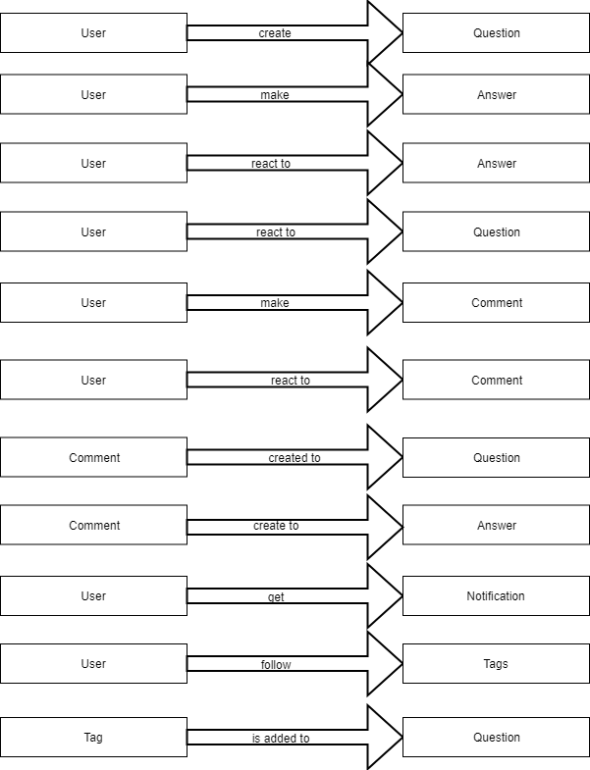
Data Object relationship

Slide 13
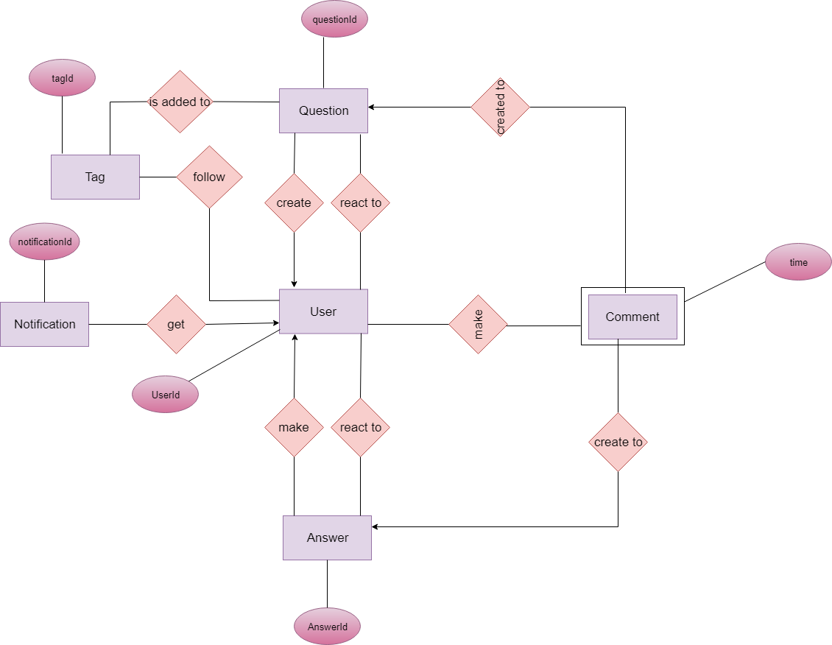
ER DIAGRAM

Slide 14
Identified Classes
User
Recommendation
Question
UserManagement
UserActivity
Answer
Tag
Comment

Slide 15
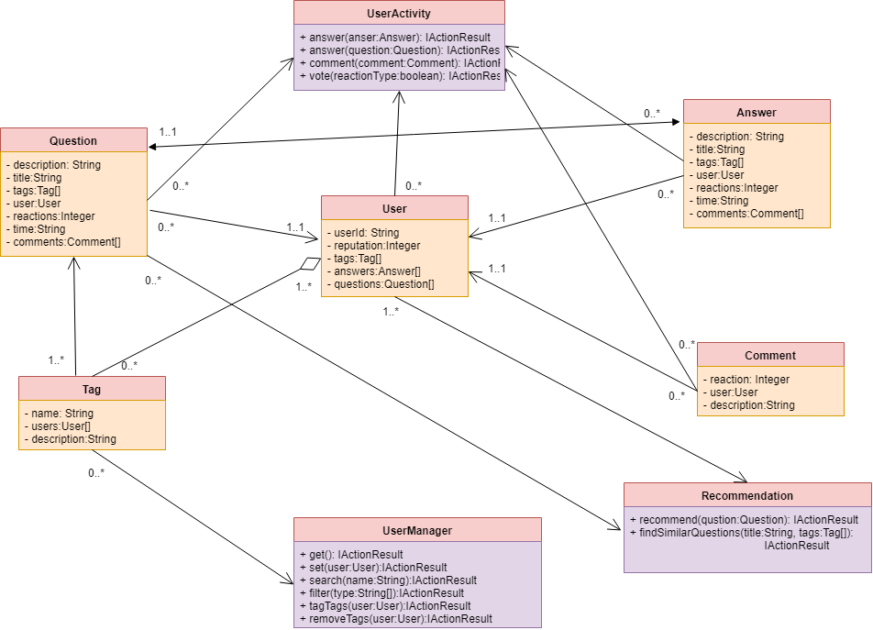
CRC DIAGRAM

Slide 16
ALGorithm implementaion
Apriori
Cosine similarity
Question suggestion to users
Similar question suggestion

Slide 17
Thank you

